Slide 1
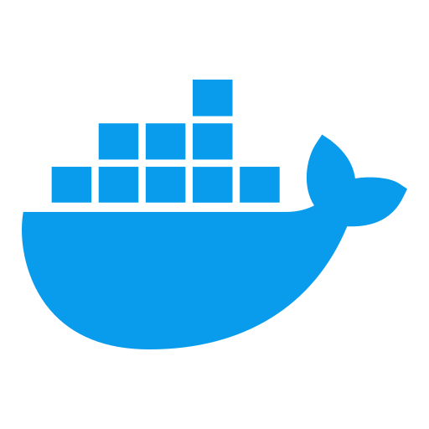
Module 11: Docker Security Deep Dive
Docker & Containerization Workshop
By TALHA

Slide 2
Learning Objectives
Implement comprehensive Docker security measures
Apply least privilege principles to container deployments
Master container and image vulnerability management

Slide 3
Container Security Architecture
Linux Security Mechanisms
Namespaces: Process isolation (PID, network, mount, etc.)
cgroups: Resource constraints
Capabilities: Fine-grained privileges

Slide 4
Container Isolation Analysis
Isolation Guarantees
Process isolation (PID namespace)
Network isolation (NET namespace)
Filesystem isolation (MNT namespace)
User isolation (USER namespace)
Isolation Limitations
Shared kernel
Potential privilege escalation
Resource contention
Docker Security Defaults
Default seccomp profile
Limited capabilities
Restricted syscalls

Slide 5
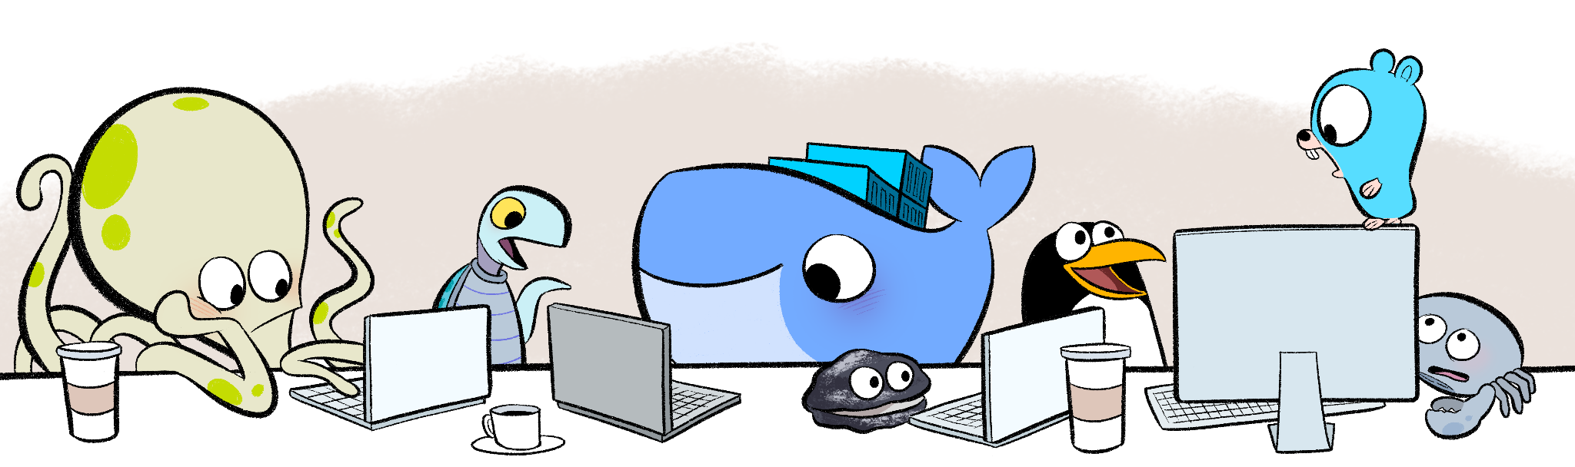

Slide 6
Attack Surface Analysis
Common Attack Vectors
Container escape
Insecure configurations
Image vulnerabilities
Excessive privileges
Privilege Escalation Pathways
Host volume mounts
Exposed Docker socket
Privileged containers
Kernel vulnerabilities
Container Escape Techniques
Unrestricted capabilities
Access to sensitive devices
Mounting host directories

Slide 7
Security Benchmark Standards
CIS Docker Benchmark
Host configuration
Docker daemon configuration
Container images and build files
Container runtime
Docker security operations
Docker Security Scanning Tools
docker-bench-security
Anchore
Clair
Trivy
Compliance Automation
Integration with CI/CD
Continuous assessment
Policy enforcement

Slide 8
Non-Root Container Configuration
User Namespace Mapping
# Enable userns-remap in daemon.json
{ "userns-remap": "default" }
Maps container root to non-privileged host user
Limits impact of container compromise
Non-Root User Implementation
# Create user in Dockerfile
RUN groupadd -r appuser && useradd -r -g \ appuser appuser
USER appuser
Application-Specific Permissions
Principle of least privilege
Run as application user
Minimal necessary permissions

Slide 9
Capability Management
Linux Capabilities Overview
Granular privileges for specific operations
Reduces need for full root access
Default Docker capabilities are limited
Dropping Unnecessary Capabilities
# Run container with limited capabilities
docker run --cap-drop=ALL --cap-add=NET_BIND_SERVICE nginx
Adding Required Capabilities
# Only add required capabilities docker run --cap-drop=ALL --cap-add=NET_ADMIN tools
Common capabilities: NET_BIND_SERVICE, CHOWN, DAC_OVERRIDE

Slide 10
Read-Only Filesystem Implementation
Read-Only Root Filesystem
# Run container with read-only filesystem
docker run --read-only nginx
Prevents runtime modifications
Reduces attack surface
Temporary Filesystem Mounts
Allow specific directories to be writable
docker run --read-only \
--tmpfs /run:rw,noexec \
--tmpfs /tmp:rw,noexec \
nginx
Required writable locations
No executable permissions
Application Adaptation
Log to stdout/stderr
Use environment variables for configuration
External storage for persistent data

Slide 11
Image Vulnerability Management
Scanning Tools Implementation
# Using Trivy to scan image
trivy image nginx:latest
# Docker Scout scanning
docker scout cves nginx:latest
Vulnerability Remediation Workflow
Regular scanning of base images
Update dependencies with vulnerabilities
Implement policy for acceptable risks
Rebuild and redeploy updated images
Continuous Scanning Integration
Pre-build scanning
Registry scanning policies
Post-deployment verification

Slide 12
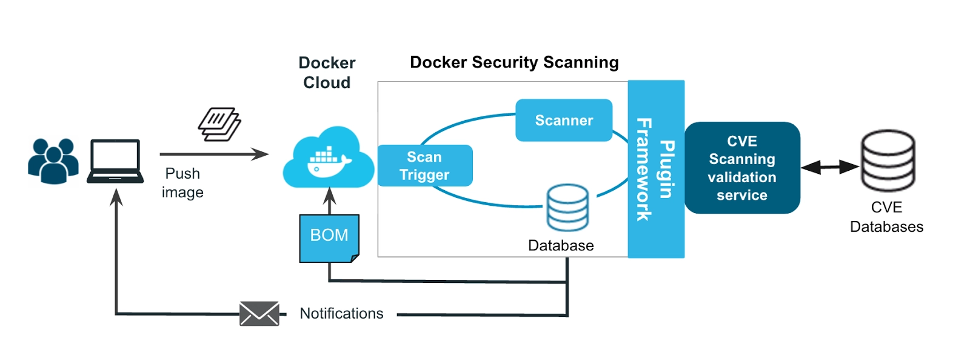

Slide 13
Image Signing and Verification
Docker Content Trust
# Enable content trust
export DOCKER_CONTENT_TRUST=1
# Push signed image
docker push myregistry/myimage:latest
# Pull with verification
docker pull myregistry/myimage:latest
Signature Verification Workflow
Image is signed during push
Signature stored in Notary server
Pull verifies signature with public key
Fails if image tampered or unsigned
Key Management Best Practices
Secure offline root key
Repository keys rotation
Hardware security modules (HSMs)

Slide 14
Base Image Security Strategy
Minimal Base Images
Alpine: ~5MB (musl libc, minimal packages)
Distroless: Language runtime only, no shell
Scratch: Empty base for statically linked binaries
# Minimal base image example
FROM gcr.io/distroless/java:11
COPY target/app.jar /app.jar
CMD ["app.jar"]
Patch Management Strategy
Regular base image updates
Automated rebuilds with dependency updates
Version pinning with security exceptions
Image Lifecycle Management
Deprecation policy
Scanning thresholds
Rebuild trigger

Slide 15
Runtime Security Monitoring
Falco Security Monitoring
Run Falco container
docker run -d --name falco \
--privileged \
-v /var/run/docker.sock:/var/run/docker.sock \
falcosecurity/falco
Real-time system call monitoring
Behavior-based anomaly detection
Customizable rule sets
AppArmor/SELinux Profiles
# Run with AppArmor profile
docker run --security-opt apparmor=docker-default nginx
Mandatory access control
Pre-defined security policies
Enforce allowed operations

Slide 16
Volume Creation and Configuration
SIEM Integration Approaches
Log forwarding to central SIEM
Security event aggregation
Correlation with host-based events
Alert Generation and Management
Severity-based alerting
Rate limiting and deduplication
Context-enriched notifications
Incident Response Automation
# Example response action
docker stop $(docker ps -q --filter ancestor=vulnerable-image)
Automated container isolation
Evidence collection
Remediation playbooks

Slide 17
Secure Deployment Pipeline
Security Gate Implementation
Pre-build security checks
Vulnerability scanning
Compliance verification
Vulnerability Policy Enforcement
Severity thresholds
Exclusion management
Compensating controls
Compliance Reporting Automation
Evidence collection
Audit trail
Compliance dashboards

Slide 18
Network Security for Containers
Container Network Isolation
# Create isolated network
docker network create --internal backend
# Connect DB to internal network only
docker run --network backend --name db postgres
# Connect app to both networks
docker run --network frontend --name app app-image
docker network connect backend app
Micro-segmentation
Service-to-service rules
Default deny policies
Limited blast radius
Encrypted Transport
TLS between services
Mutual authentication
Certificate rotation

Slide 19
Secret Management for Containers
Docker Secrets
# Create secret (in Swarm mode)
echo "mypassword" | docker secret create db_password -
# Use secret in container
docker service create \
--secret db_password \
--env DB_PASSWORD_FILE=/run/secrets/db_password \
postgres
External Secret Stores
Vault integration
Cloud provider secret services
Kubernetes secrets
Secret Injection Patterns
Environment variables
Volume mounts
Init containers

Slide 20
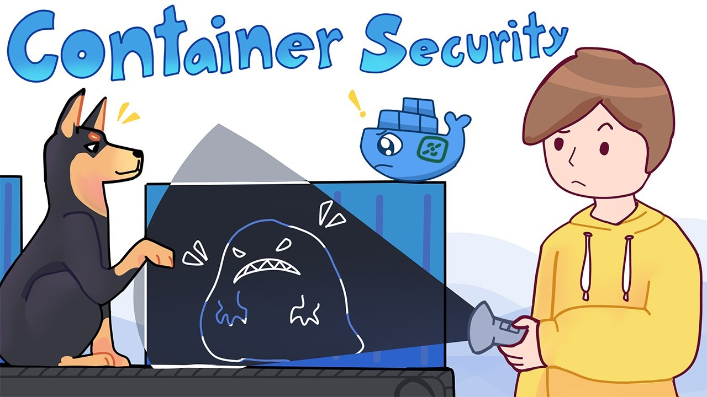

Slide 21
Hands-on Exercise: Container Security Hardening
Exercise Objectives
Implement least privilege containers with non-root users
Configure read-only filesystems with exceptions
Test security with vulnerability scanning tools
Steps
Create baseline container deployment
Add non-root user configuration
Implement capability restrictions
Configure read-only filesystem
Run vulnerability scan
Test functionality with security controls

Slide 22
Hands-on Exercise: Runtime Security Implementation
Exercise Objectives
Set up runtime security monitoring
Create security profiles for document analysis components
Test and validate security configurations
Steps
Install and configure Falco
Create custom detection rules
Set up AppArmor/SELinux profiles
Test with security scenarios
Implement logging and alerting
Document security controls

Slide 23

Questions?

